Slide 1

Data Science & AI Program Course
Capstone Project
Speech Emotion Recognition
using Convolutional Neural Networks (CNNs)
Thomas Stoll
April 2023

Slide 2
What is
Speech Emotion Recognition?
The process of identifying and classifying the emotions conveyed in human speech.
Emotions are expressed in speech through a combination of
acoustic features (pitch, loudness, speech rate)
linguistic features (word choice, syntax)
Speech emotion recognition systems
use machine learning algorithms to analyse these features
classify the emotional state of the speaker (happy, sad, angry etc.)

Slide 3
Why is it important?
Speech emotion recognition is an important area of research and development.
It has numerous applications:
Improving communication and interpersonal interactions
Diagnosing mental health conditions
Personalizing marketing and customer service
Improving human-computer interaction

Slide 4
Business Question
How can speech emotion recognition systems be improved
to classify the emotions conveyed in human speech more accurately?

Slide 5
Data Pipeline
Data
exploration &
visualization
CNN
Modelling
Business
question
Feature
extraction
Communicating
data insights

Slide 6
Data Summary
 | RAVDESS | TESS
Datatype | Audio (.wav) | Audio (.wav)
Number of files | 1440 | 2800
Description | Speech, 24 professional actors vocalizing 2 statements | Speech, 2 actresses, 200 target words were spoken in the carrier phrase “Say the word _____”
Emotions | 8 (neutral, calm, happy, sad, angry, fear, disgust, surprise) | 7 (neutral, ----, happy, sad, angry, fear, disgust, surprise)
Datasets (from Kaggle):
Ryerson Audio-Visual Database
of Emotional Speech and Song
(RAVDESS)
Toronto Emotional Speech Set
(TESS)
Total number of audio files: 4240

Slide 7
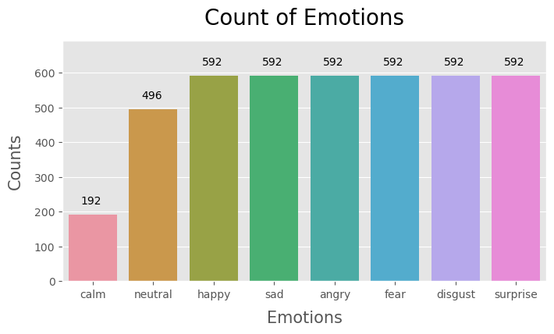
Emotions:
Number of audio files
‘Calm’ is under-represented (5%), while all other emotions show equal representation (12-14%)

Slide 8
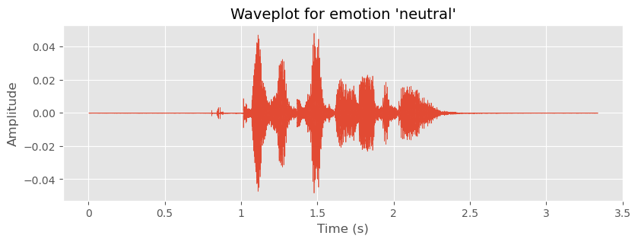
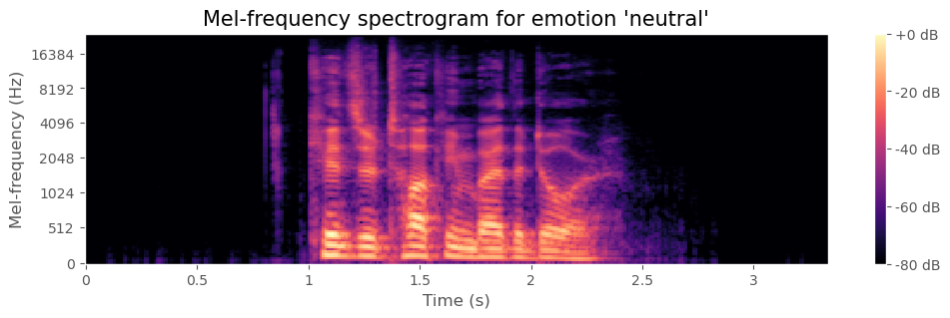
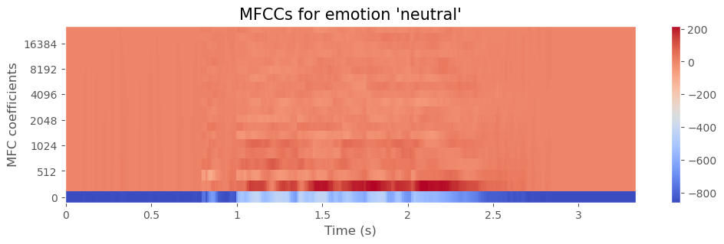
Visualizing
audio data
Waveplots (2D) show time and amplitude (intensity) of an audio signal
Waveplot
Spectrogram
MFCCs (Mel-frequency cepstral coefficients)
Spectrograms (3D) show the spectrum of frequencies changing with time
MFCCs (3D) represent the spectral characteristics of an audio signal

Slide 9
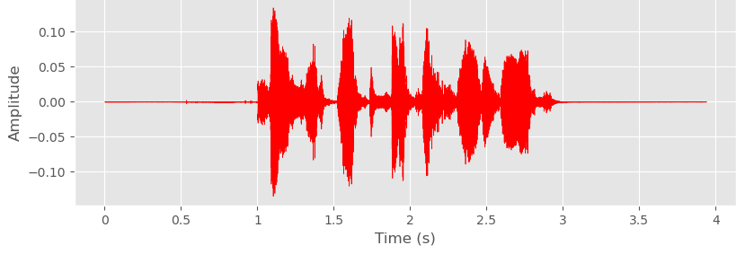

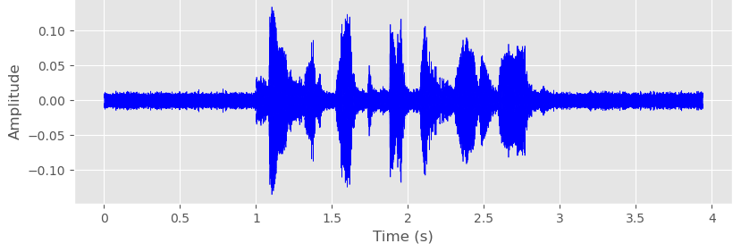
Data Augmentation
Original
Emotion: Angry
Injecting
noise
Perturbations:
Noise injection
Shifting time
Changing pitch
Changing speed
Objective: Enhance the ability of the model to generalize
Process: Creating new synthetic data from existing data by adding small
perturbations
Caution! Adding perturbations must conserve the label of the original data

Slide 10
Audio Feature Extraction
# | Feature extraction method | Output of samples | Output dimension of feature map
1 | Mean MFCCs | 4240 | 1D (40,)
2 | Combination of features (MFCCs, ZCR, RMSE) plus augmentation (noise, pitch) | 16960 | 1D (9072,)
3 | MFCCs | 4240 | 2D (40, 216)
4 | (Mel) Spectrogram | 4240 | 2D (64, 216)
Audio file pre-treatment:
Re-sampling to 22 kHz and
re-sizing to 5 s in length
4 different feature extraction methods were applied
MFCCs (Mel-frequency cepstral coefficients): Represent the spectral characteristics of an audio signal
ZCR (Zero Crossing Rate): Rate at which an audio signal changes
RMSE (Root-Mean Square Energy): Average loudness of an audio signal over time

Slide 11
Data pre-processing
Split data into train (80%) and test (20%)
Scale data into a range between 0 and 1
Reshape data to fit the CNN model input shape
Encode target values to a binary class matrix (label encoding)
Split
Scale
Reshape
Encode

Slide 12
CNN Model Performance
Emotion
Neutral
Calm
Happy
Sad
Angry
Fear
Disgust
Surprise
Precision | Recall | F1-score | # Samples test data
0.90 | 0.97 | 0.94 | 397
0.79 | 0.82 | 0.81 | 153
0.96 | 0.93 | 0.95 | 473
0.96 | 0.93 | 0.95 | 473
0.96 | 0.96 | 0.96 | 474
0.98 | 0.94 | 0.96 | 474
0.97 | 0.95 | 0.96 | 474
0.97 | 0.98 | 0.97 | 474
Best feature extraction method:
Multiple features plus augmentation
 | # Samples
Total | 16,960
Train | 13,568
Test | 3,392
Model accuracy: 95%
F1-score ≥ 94% for all emotions
except ‘calm’

Slide 13
Summary
The accuracy of speech emotion recognition can be improved by data quantity and diversity, choice of feature extraction method and possibly augmentation
Models tend to overfit with small datasets – e.g., when using the RAVDESS only – even when augmented data was added
A total of 4 feature extraction methods were compared
Best feature extraction method was the extraction of multiple features plus augmentation
The CNN model architecture was optimized by trial and error using learning curves as assessment tools
A neural network with 4 convolutional and 2 fully connected layers was the best performer, resulting in an accuracy of 95% and F1-scores of ≥94% for all emotions (except ‘calm’)
How can speech emotion recognition systems be improved
to classify the emotions conveyed in human speech more accurately?

Slide 14
Next Steps
Due to the excellent model performance, the model is ready to be deployed
The robustness of the model could be improved by adding more datasets
A possible future application could be to combine speech emotion recognition with NLP for emergency call triage

Slide 15
Best Performer CNN Model Details
Model: Sequential
Input | (9072, 1)
4 blocks of layers: Conv1D MaxPool1D Dropout | nodes per block: 128, 128, 64, 32; kernel: 5; activation: relu pool: 2 0.2
Flatten layer
Dropout layer | 0.5
Dense layer | nodes: 256; activation: relu
Dense output layer | nodes: 8; activation: softmax
Optimizer | adam (learning rate=0.001)
Loss function | categorical_crossentropy
Metrics | accuracy
Epochs | 30

